Slide 1
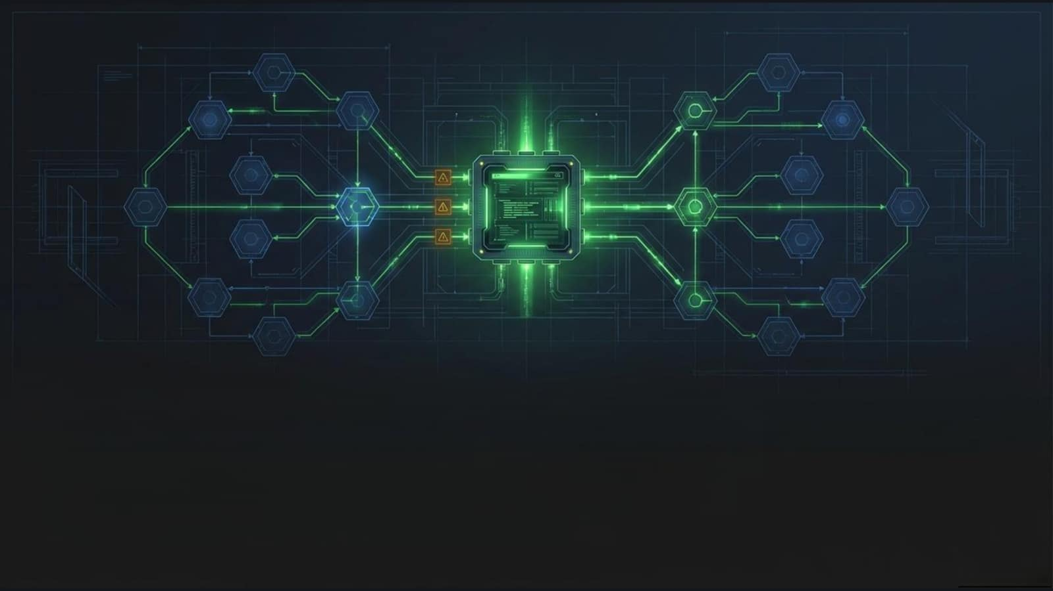
Evolving to Agentic Operation
Orchestrating Dynatrace Intelligence, Kubernetes,
and human expertise to eliminate IT toil.

Slide 2
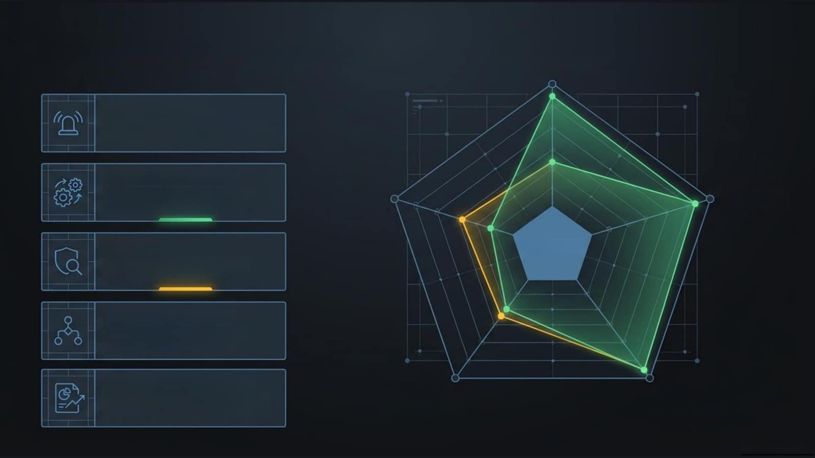
The automation blast radius
Incident Response
Incident Response
Grouping alerts and triggering targeted Slack/Email routing.
Automated Remediation
Executing system runbooks to fix recurring anomalies automatically
Security Triage
Automated Remediation
Security Triage
Aggregating thousands of security events to cross-check threats.
Workflows
Toolchain Orchestration
Syncing Dynatrace state with Jira ServiceNow, and external APIs.
Administration & Reporting
Delivering the Daily Dynatrace Assisted Report and optimizing cloud costs.
Administration & Reporting
Toolchain Orchestration

Slide 3
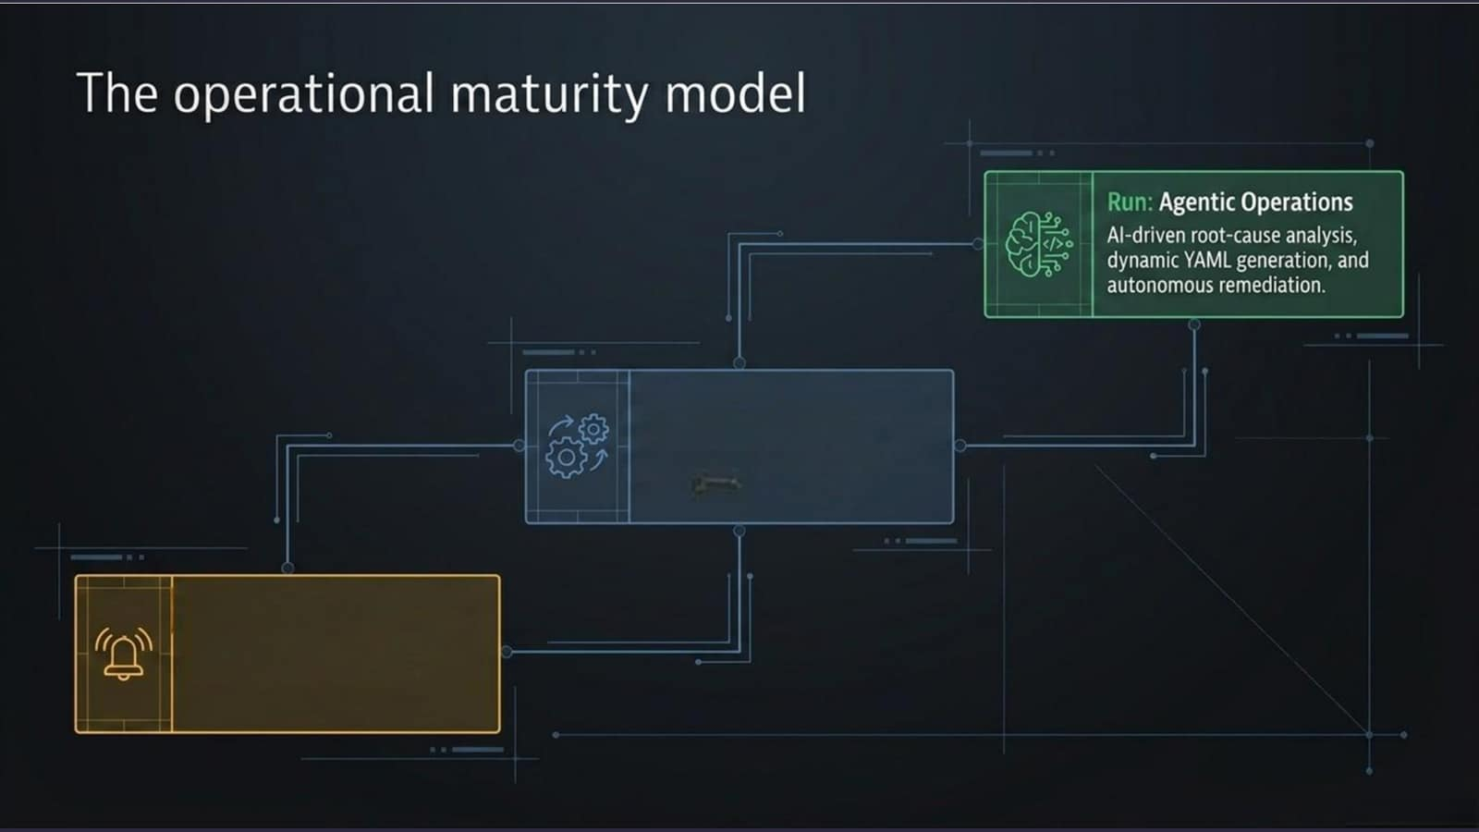
Walk:Standard Automation
Multi-stepconditional logi,
loops, and integrations with
third-party tools.
Crawl: Simple Notifications
Directing Grail data to human
eyeballsvia email or Slack.

Slide 4
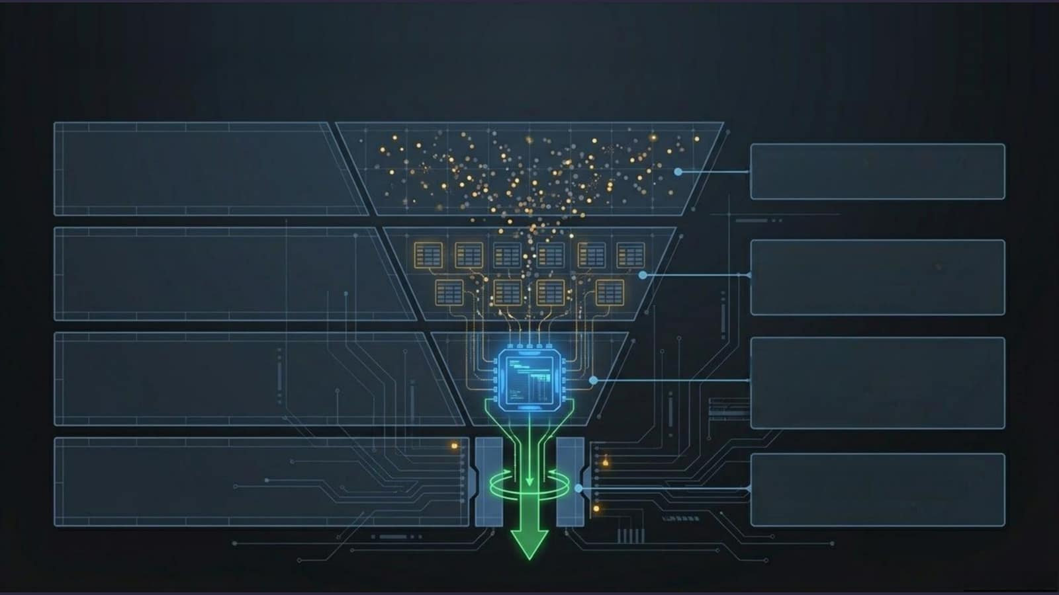
Filtering chaos intotated execution
Raw Telemetry: CPU spikes,hh
failure ratescutom logex
Davis Events:Alerts raised against
specific thresholds.
fetch dt.davis.events
The Problem:Dynatrace Intelligence
groupsrelatedeventsintoasig
root-cause entity.
fetch dt.davis.problems
The Trigger: Firing workflows based
on precise metadata (e.g., specific
Kubernetes namespaces).

Slide 5
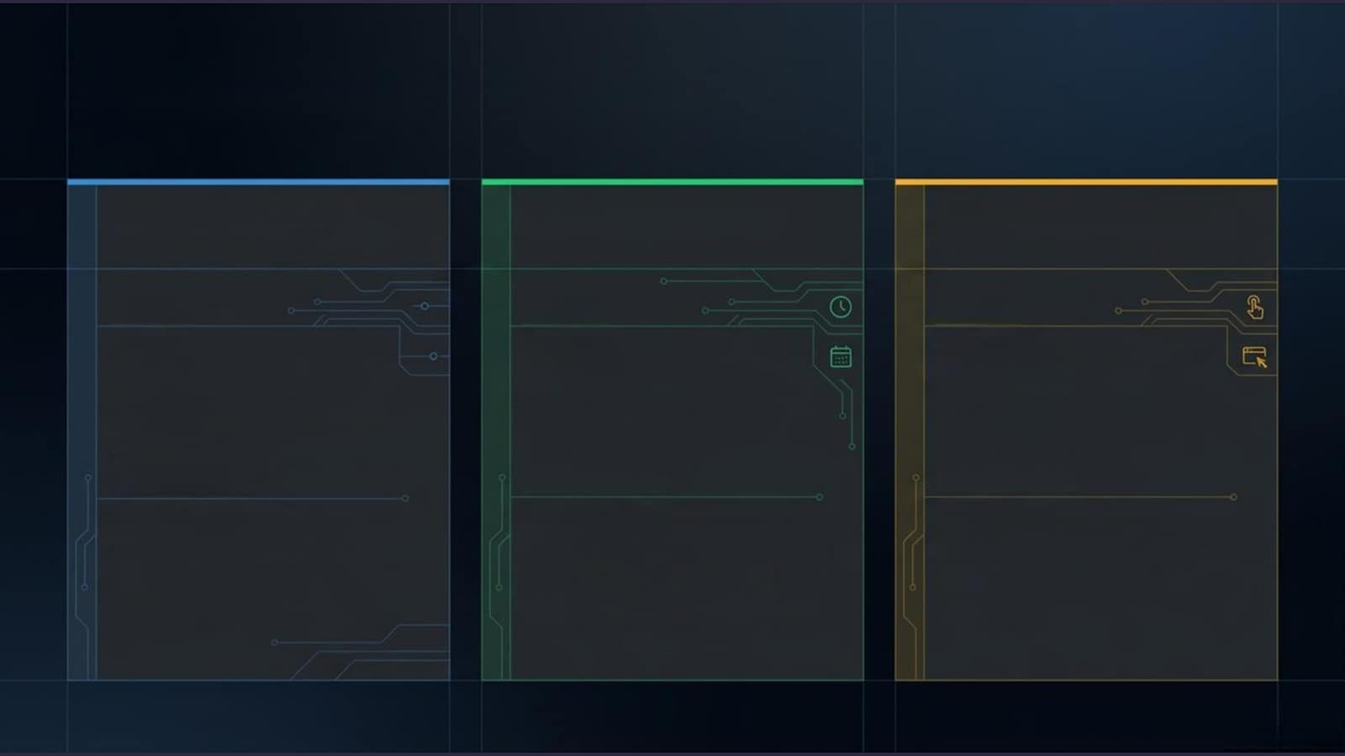
The architecture of initiation
Event Triggers
Schedule Triggers
On-Demand Triggers
Target
Target
Target
Grail data
Routine reporting and
Ad-hoc tasks or external
(dt.system.evets,
maintenance tasks.
system integrations.
security.events,Davis
problems).
Mechanism
Mechanism
Mechanism
Fires automatically when
Time-based CRoN execution
Fired manually via the UIor
specific filter criteria are
or advanced Calendar Rules
programmatically via API
met.
(e.g., Every Wednesday,
calls.
excluding Austrian holidays.

Slide 6
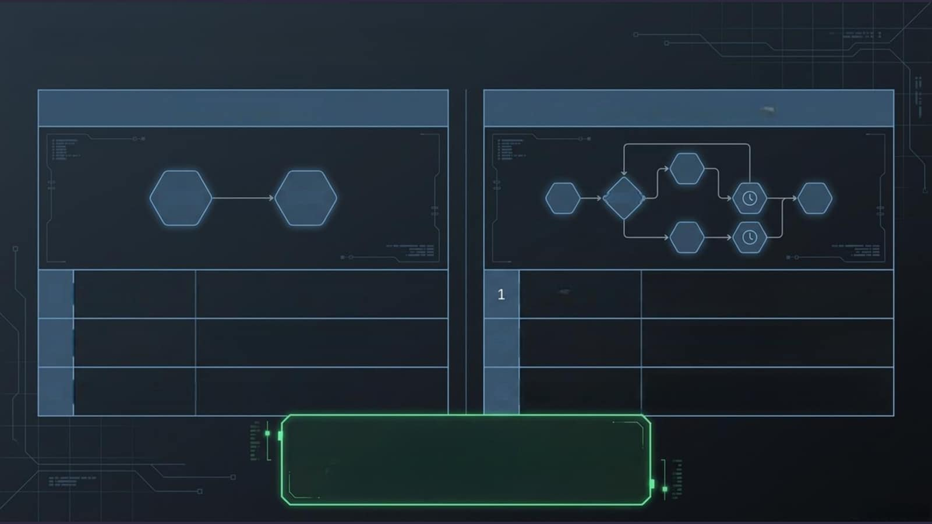
Classifying workflow complexity
Simple Workflows
Standard Workflows
TRIGGER
ACTION
CONDITION
1
Architecture:
1 Trigger + 1 Action
Architecture:
Multiple actions, branching,
loops, delays.
2
Licensing:
No workflow licensing cost,
2
Licensing:
Licensing costs apply ONLY
only execution billed.
when published to Live.
3
Observability:
Basic system events.
3
Observability:
Detailed UI execution history,
visual path tracking, deep logging
The Draft Advantage
Standard workfLows cost nothing in Draft mode.
SREs can maintain a Live version while
safely testing iterations in parallel.

Slide 7
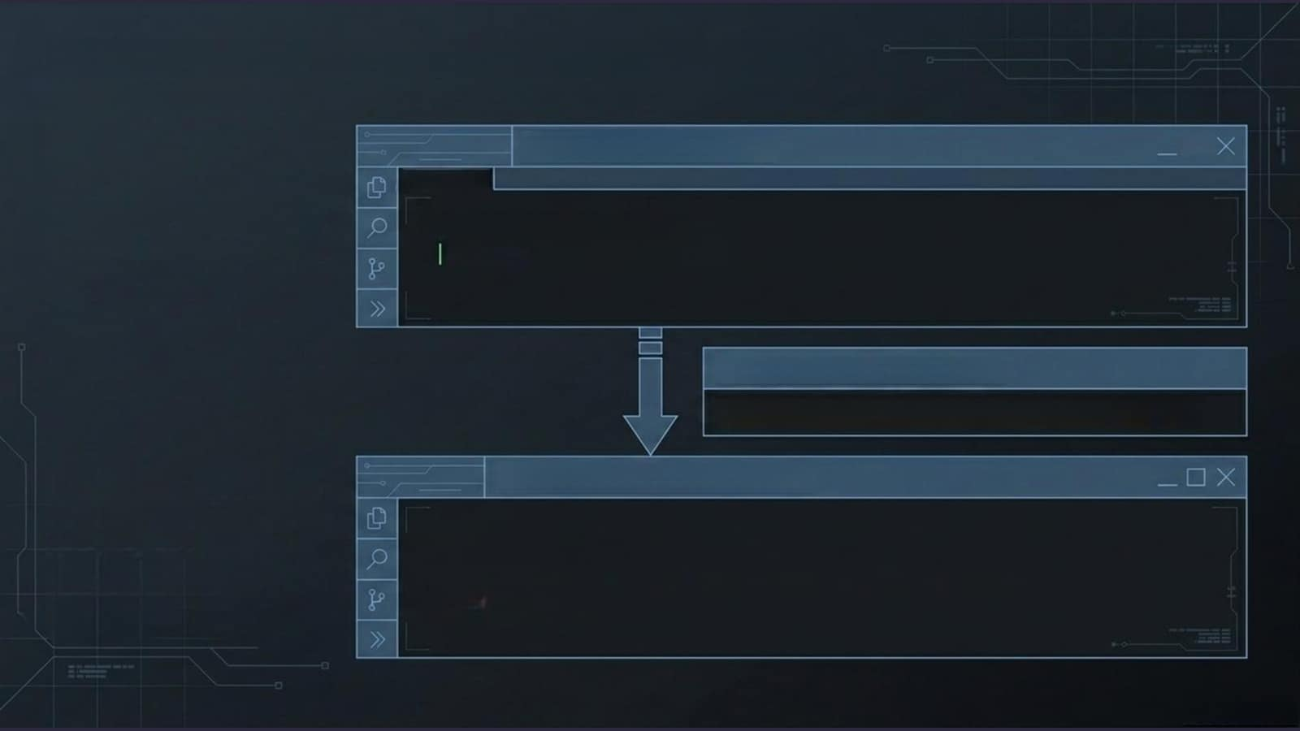
Dynamic context passing with Jinja
Concept 1: The Query
□
Termlnal ×
Action tasks query Grail
fetch dt.davis.problems
for real-time context.
filter duration > 24h
Concept 2: The Hand-off
result('fetch_problem_with_dql').records
Concept 3: The Formatting
Jinja enables loops and
control structures,
{% for record in records %}
formatting raw JSoN
{{ record.problem_id }} - {{ record.status }}
into specific API
{% end for %}
payloads.

Slide 8
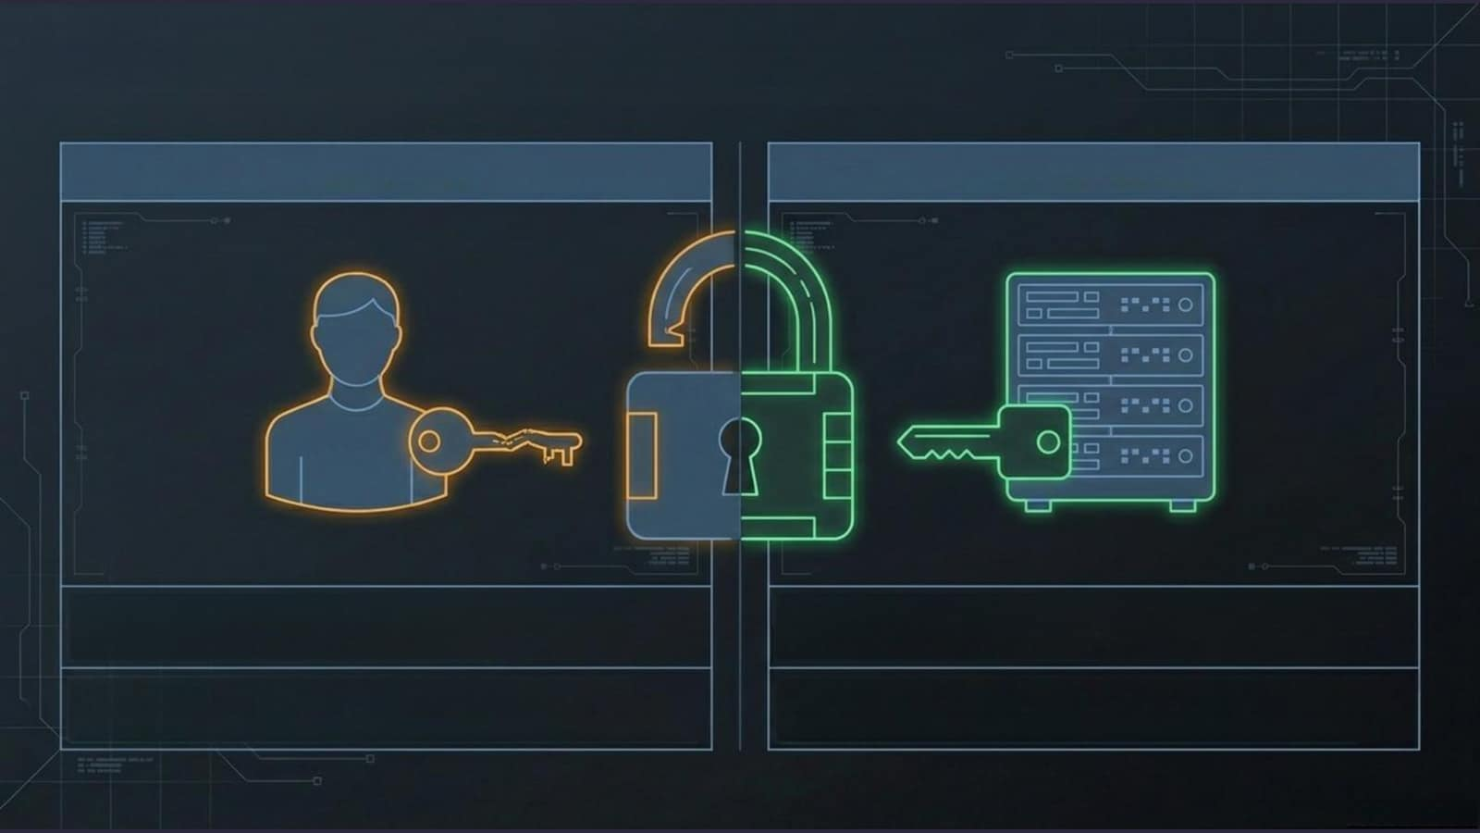
Securing execution with Service Actors
User Actors
Service Actors
Default behavior. Workflows execute using the
Best practice for Live workflows. Execution is bound to
permissions of the individual creator.
a dedicated service identity.
Ideal for personal reporting and draft testing,but
Isolates security boundaries, limits permissions, and
brittle-if the user changes roles,the workflow breaks.
guarantees resilience regardless of team turnover.

Slide 9
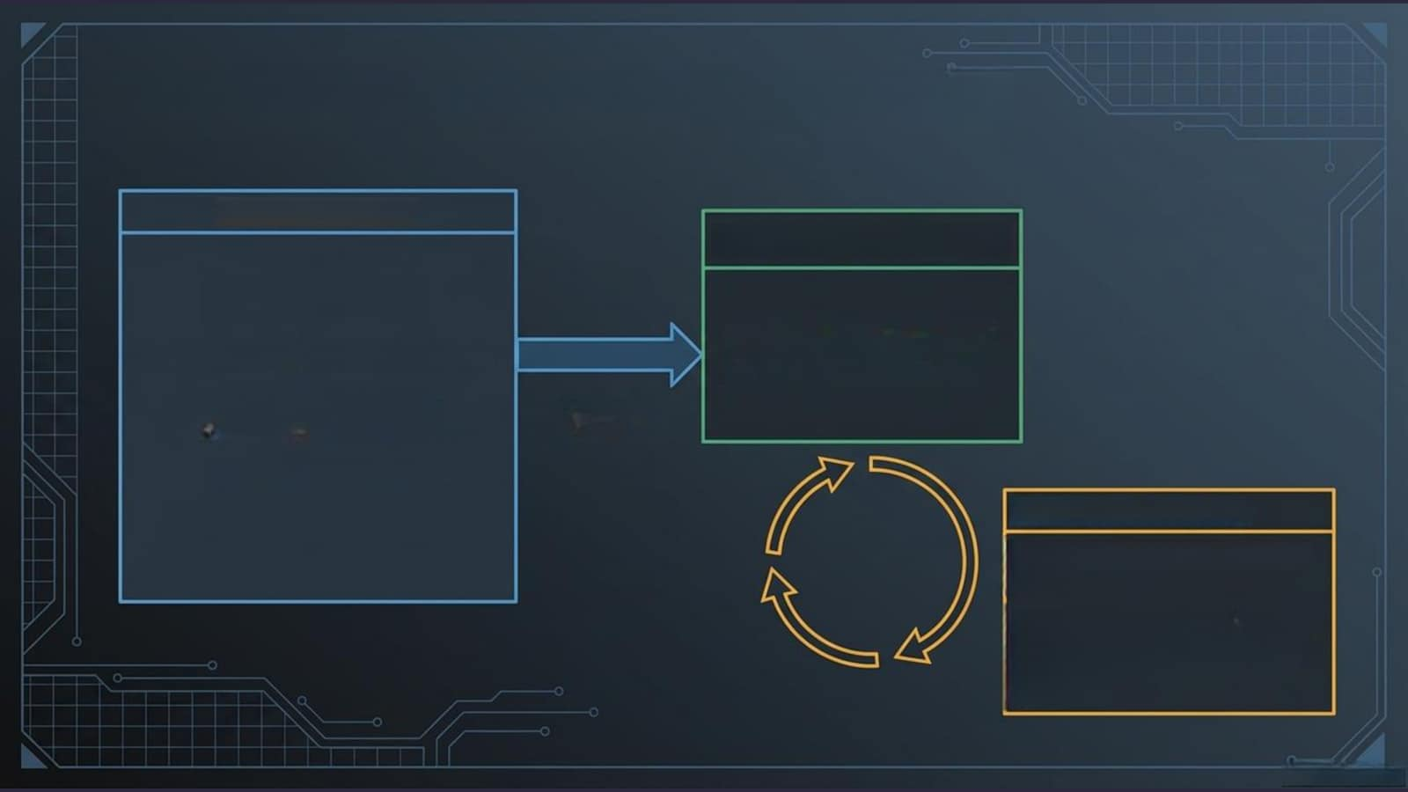
Modular execution and sub-workflows
The Orchestrator
The Agent (Sub-workflow)
Encapsulated logic that
Captures trigger (K8s anomaly).
can be reused across
different orchestrators.
Injects global inputs
Variable
(e.g., 'no pull requests').
Injection
Calls sub-workflow.
Resilience Controls
Wrap sub-workflows in retry
logic.
Example: automatically retry
a failed execution 5 times,
pausing 60 seconds between
attempts.

Slide 10
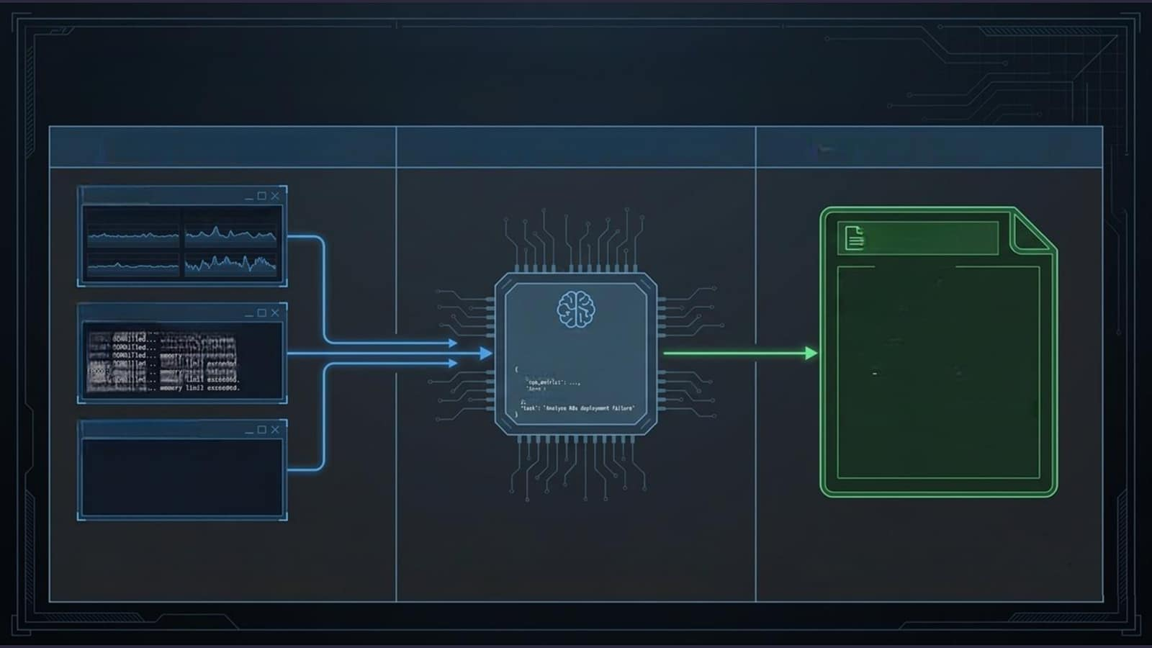
Anatomy of a Kubernetes troubleshooting agent
Phase 1: Context Gathering
Phase 2:Dynatrace Intelligence
Phase 3: YAML Extraction
CPU Metrics
DQL query running:SEεET arg(cpu) FD Bs.pod...
patch.yaml
apiVersion:apps/v1
kind:Deployment
Memory Logs
metadata:
name: problematic-app
ER000:0091T1ed
mcry linit extosded.
spec:
20000:
ssoory
Lnit exreeded.
LLM Prompt
template:
ERGOG:
scary
lindl esceeded.
Assembly
spec:
20009:
lloll extseded.
containers:
EP900:
cooouTled
soecry
linit exresded.
conteats
Rame:app-container
20000:
ssoory
resources:
E0000:001Tled
'sdatery':..
llmits:
from 256Mi
mEmory:"S12Mi"#Increased
Previous Fix Attempts
requests:
Fix 4221 faiTed: Roltback lailiated.
memory:"256Mi"
Runs parallelDQL queriesagainst Grail to
All context is bundled into an LLM prompt.
The Al isolates the root cause and
pullCPU metrics,memory logs,and a
The Al acts as a Kubernetes expert
generates the exactYAMLconfiguration
record of previously triedfix attempts.
analyzing the specific deployment failure.
needed to patch the deployment.

Slide 11
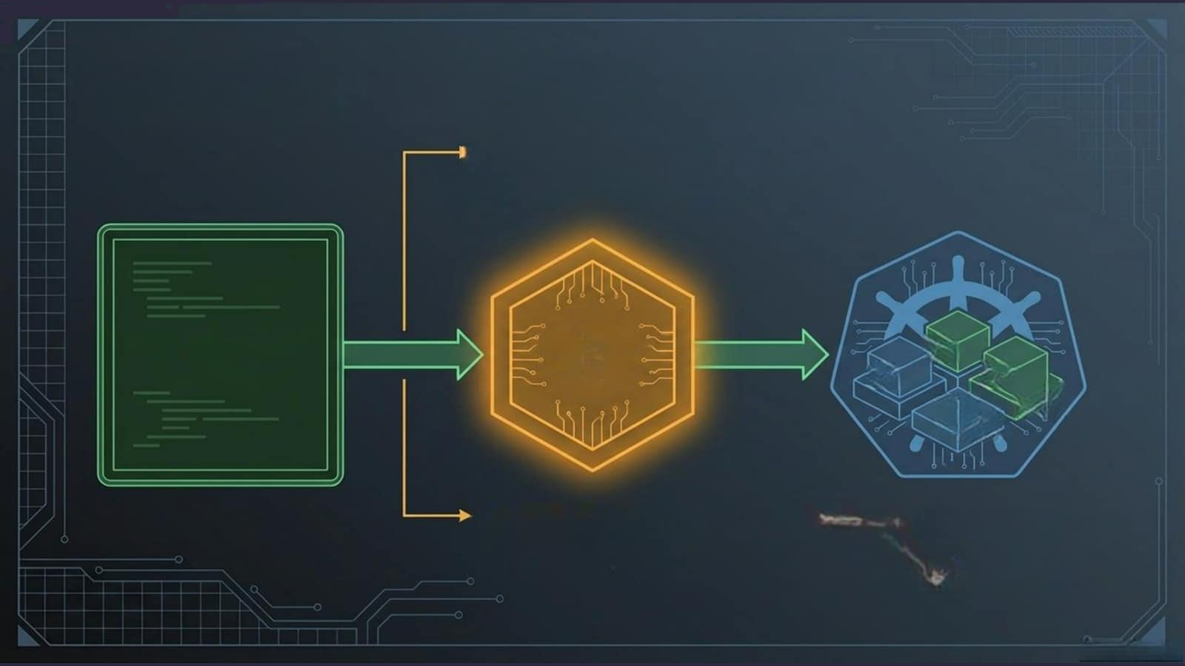
Al speed with humani-the-oopa
The Request Approval Step:
Executionhalts.Analertissentcontainig
the AI diagnosis and proposed YAML fix.
The
AI-Generated
Human
PODS
YAML
Gate
PODS
SSRVICES
NODES
NAMESPACE
The system waits. Only when
The Resolution: YAML configuration is
the SRE clicks Approve does
applied.The workflowwaits 15minutes,
the workflow proceed.
runs a DQLverificationqury,and
automaticallycloses the issue.

Slide 12
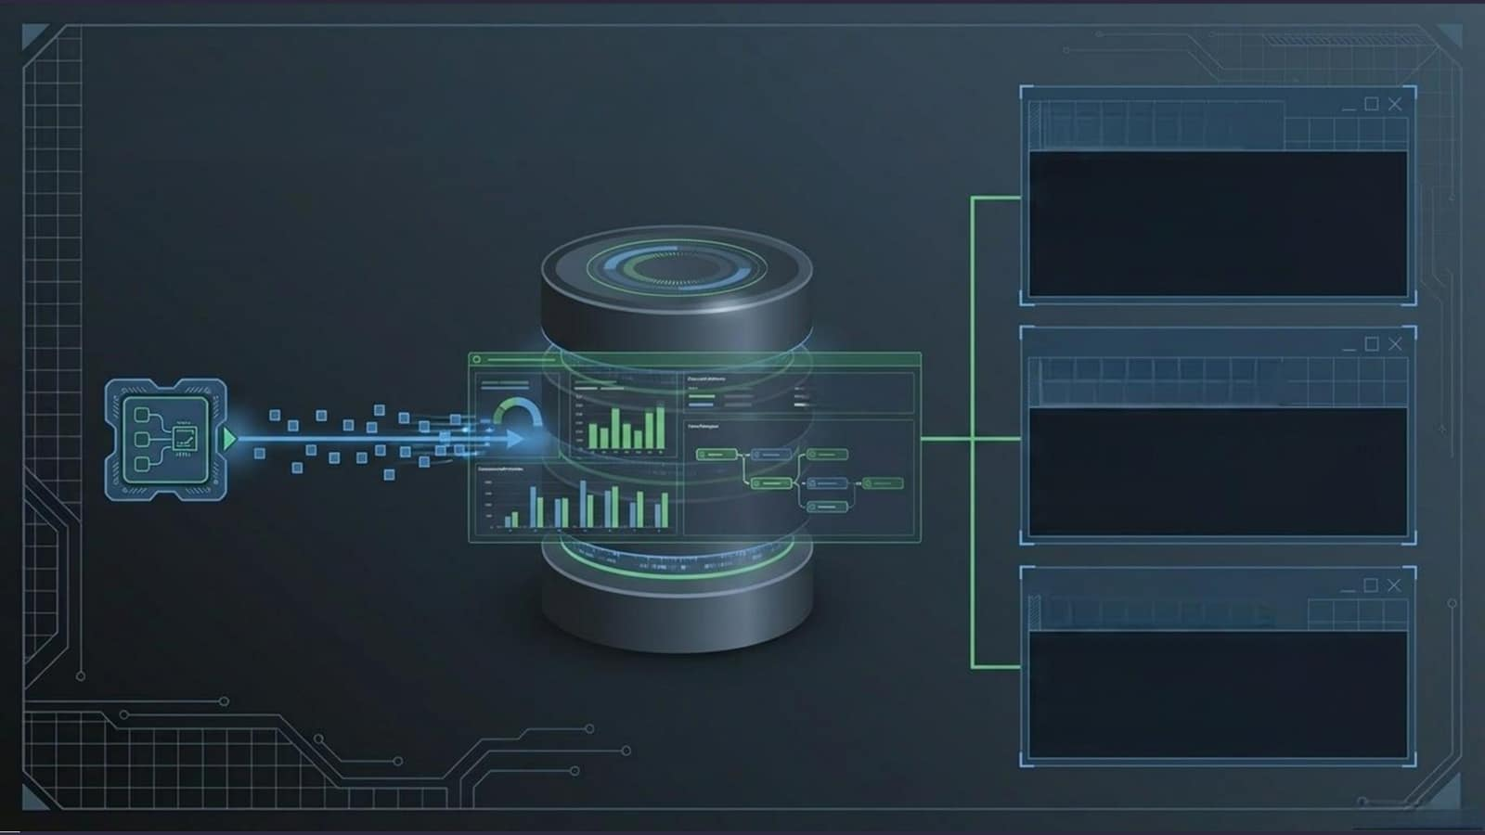
Monitoring the monitors
System Events
Every workflow lifecycle change,
execution result,and task failure
is permanently logged as a
dt.system.event in Grail.
山
Visual Debugging
Standard workflows provide deep,
step-by-step Ul logs and visual
path tracking for immediate
troubleshooting.
Meta-Automation
Build custom dashboards to track
execution times,or build a
workflow that alerts you when
anothercritical workflow fails.

Slide 13
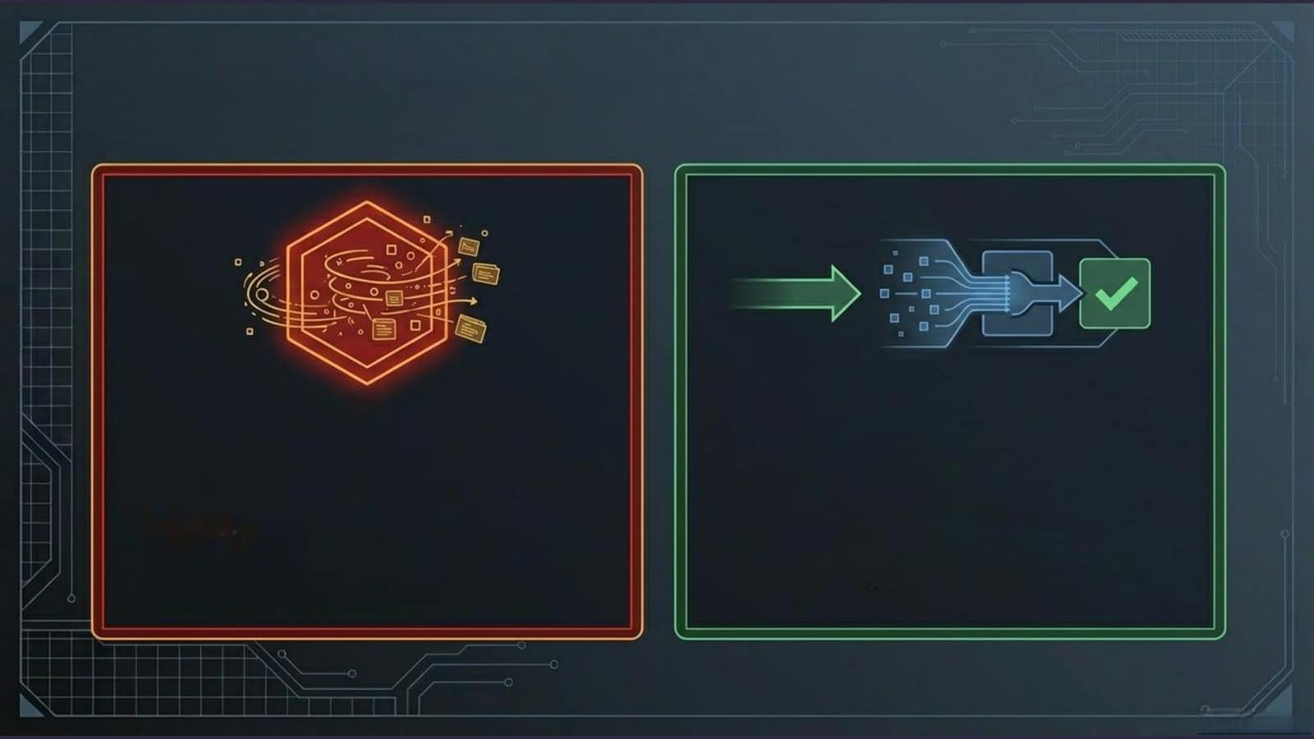
Architectural anti-patterns
The Trap
The Solution
Using Worwtoexress
Formassivetelemetry,routedata through
millions of raw metrics continuously.
OpenPipeline or use dedicated Dynatrace
extensions.
The Reality:Workflowsareanorchestrationengine.
The Reality:Worklowsareanorchestrationengine.
Keep Workflowsstrictlyreservedforhigh-value
Everystepishiglauitedushinmasiveata
business logic and decision orchestration.
pipelinesthroughthemcausessystemic bloat.

Slide 14
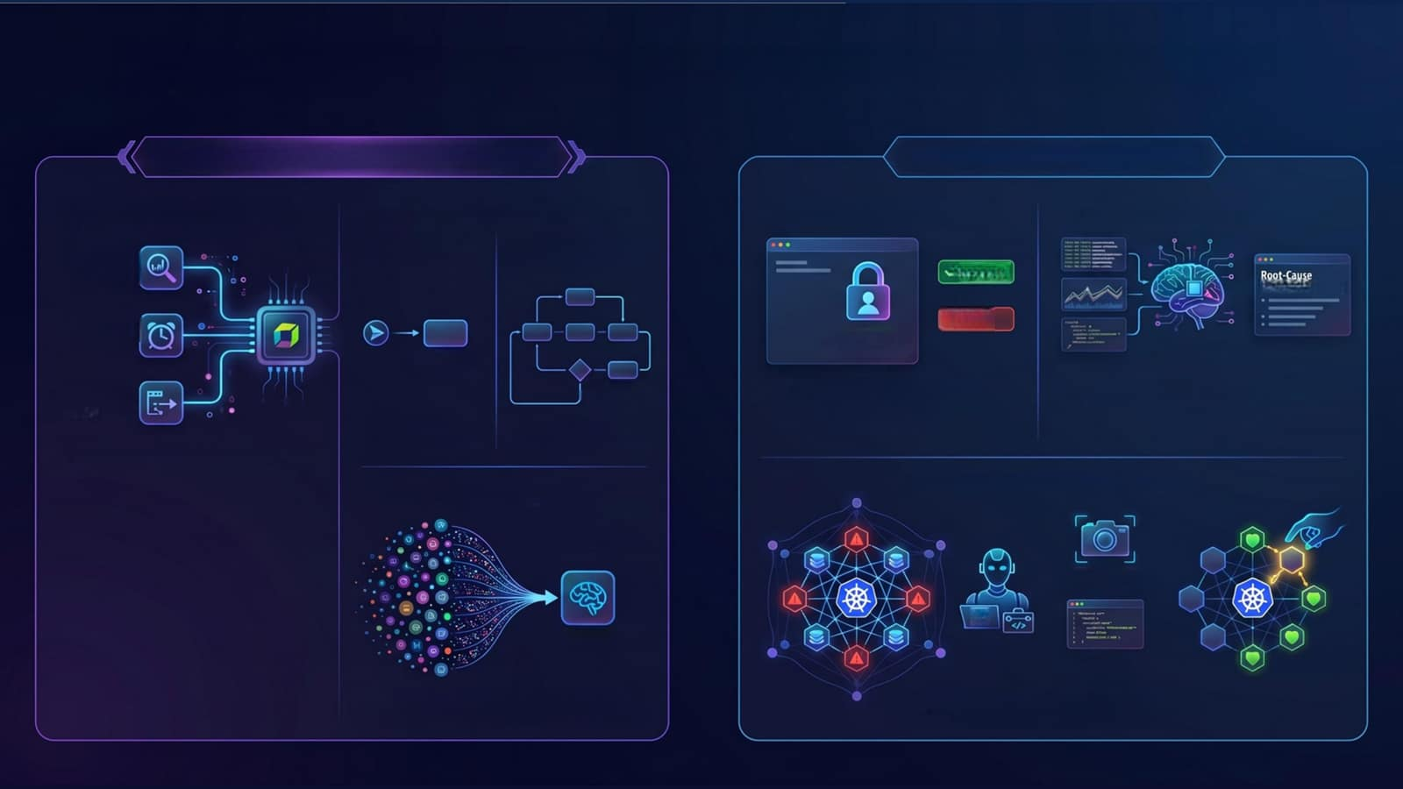
Beyond Notifications: Mastering Dynatrace Agentic Workflows
THE FOUNDATION TO DYNATRACE WORKFLOW
SCALING TO AGENT ICOPERATIONS
Workflow Trigger Categories
Simple
VS.
Standard
Workflows
Human-in-the-Loop Approvals
Agentic Troubleshooting Steps
Simple Workflow
(free execution only)
Standard Workflow
(Workflow License + Execution)
Grail Events
Approve
Recommendations
Fixed Schedules
Pause for Authorization
× Deny
1 Action Step
Dynatrace Intelligence
On-demand API Calls
Unlimited
Use "Approval Requests" to pause workflows for human authorization before high-impact changes.
Leverage Dynatrace Intelligence (LLMs
to analyze logs and metrics for root-cause)
recommendations.
Action Steps
Best For:
Basic Notifications
Best For:
Complex Remediation
Execute automation based on Grail events fixed schedules, or on-demand APl calls.,
Davis AI Event Aggregation
Automated Kubernetes Remediation
Evidence Capture
AI
Problem
Agent
Suggested
YAMLFix
Dynatrace Intelligence groups thousands of
Individual events into single, actionable "Problems."
Agents can capture evidence, suggest YAML fixes,
and apply them directly to clusters.

